Slide 1


Introduction to R
Data Exploration and Visualisation (Pt 2)

Slide 2
Recap
ggplot(dataframe, aes(x =visit, y=mean_phago) + geom_boxplot()
Ggplot syntax
Plotted bar charts, boxplots, and correlations
Customised the colour and themes of our graphs
Split data by faceting variables
Notes:
Re-recommend going over data set up tutorial (2)

Slide 3
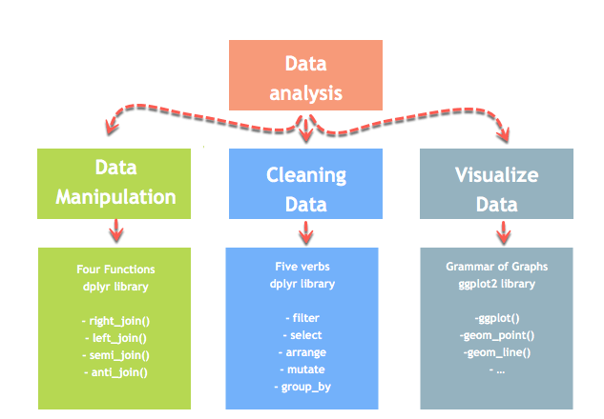
Today's objectives
Go over joining/merging data frames
Produce more graphs with GGPLOT and GGPUBR
Add statistical significance to our plots

Slide 4
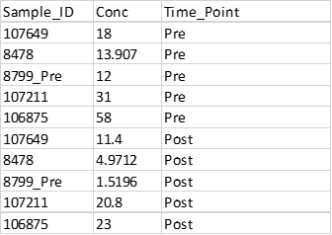
Data set up
Data for plotting needs to be organised in long format (see tutorial 2 for more details)
Data is set up so that each time point, and technical replicate are on separate rows
Recode any categorical variables to factor using as.factor()
Extra metadata can be added to the data frame using dplyr:join functions
IgA Titre | IgG Titre
2 | 10
4 | 12
5 | 15
2 | 10
Notes:
Factors necessary as we will want to plot our data according to these different groups

Slide 5
Joining data
Two main approaches
1) is using dplyr joins (similar syntax to SQL)
2) is by using data.table merge functions (similar syntax to STATA)

Slide 6
Joining data
left_join(original_df, extra_df, by = c(“Joining var 1", "Joining var 2”))
left_join(phago_data, age, by = c(“Sample_ID", “Visit”))
Function | Objective
left_join() | Merge two datasets. Keep all observations from the original table
right_join() | Merge two datasets. Keep all observations from the extra table
inner_join() | Merge two datasets. Excludes all unmatched rows
full_join() | Merge two datasets. Keeps all observations
Original df, A, X
Extra df, B or Y
Notes:
Can join by one key/ID variable or more than one e.g AMPLE_ID and Visit
Left join filters out any extra data that we don't have in our orginal dataset, generally useful if you have collected more information/meta data on your samples, but your only intrested in getting information for this subset of participants you did an experiment on
Right join does the oposite, data that doesn’t have a match in your origina table is excluded and all data from the joining/extra table is kept
Inner_join excludes all unmatched rows
Full join keeps everything

Slide 7
Joining R – base R or data.table
More similar to stata
Syntax merge(original_df_x, extra_df_y, by. = Joining variables, all. = TRUE/FALSE...)
DPLYR Function | Objective | Merge function
left_join() | Merge two datasets. Keep all observations from the origin table | merge(df_x, df_y, by = JoiningCols, all.x = TRUE)
right_join() | Merge two datasets. Keep all observations from the destination table | merge(df_x, df_y,, by = JoiningCols, all.y = TRUE)
inner_join() | Merge two datasets. Excludes all unmatched rows | merge(df_x, df_y,, by = JoiningCols, all = TRUE)
full_join() | Merge two datasets. Keeps all observations | merge(df_x, df_y, by = JoiningCols)
Notes:
Don’t specify the type of merge as a different function, specified within the merge function instead
All = x keeping all the observations inside th
x, y - the 2 data frames to be merged
by - names of the columns to merge on. If the column names are different in the two data frames to merge, we can specify by.x and by.y with the names of the columns in the respective data frames. The by argument can also be specified by number, logical vector or left unspecified, in which case it defaults to the intersection of the names of the two data frames. From best practice perspective it is advisable to always specify the argument explicitly, ideally by column names.

Slide 8
Explore in R
Join age and ELISA data to our original phagocytosis experiment

Slide 9
GGPUBR
GGPLOT Wrapper (very similar syntax)
Makes plotting publication quality graphs easier with little formatting
Particularly good for box plots and adding statistical significance
ggplot(dataframe, aes(x= visit, y= mean_phago, fill = Variable to colour data by)) + geom_boxplot() + extra layers/customisation
ggbarplot(dataframe, x= visit, y= mean_phago, fill = Variable to colour data by, extra customisations)
Notes:
https://mode.com/blog/r-ggplot-extension-packages/
- Ggplot has x and y separate aes argument, type of plot and extra customisation other than color is done by the + sign
- GGPUBR specify type of plot beforehand, has preset customisations/options that you can do all within one function
I tend to use a mix! Recommend getting to know ggplot (helps you learn code), but also start to include ggpubr, eventually you may switch most of your plotting to it.
Again try save a separate script of plot code, that way you can reuse it when you want to make a similar type of graph but different data set again

Slide 10
Explore in R
ggbarplot and ggboxplot
Notes:
Leave ggplot comparison for them

Slide 11
Adding statistical significance to plots
http://www.sthda.com/english/wiki/comparing-means-in-r
I use the +stat_compare_means function
Define your comparisons beforehand, then + to plot ☺
Notes:
If it takes too long powerpoint your significance, check the resolution of your plots when exporting
Rstatix package more manual comparisons

Slide 12
Combing Plots
Cowplot
Patchwork

